Slide 1
PowerBI Project E-Commerce Sales Analysis

Slide 2
In this Dataset we have some Customer made different purchase, and their order was recorded in order to make a proper analysis on the whole transaction, In the analysis process , we have severe steps we have taken.

Slide 3
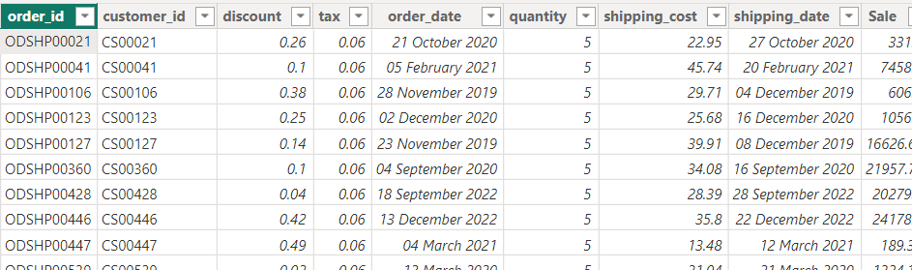
Firstly, I imported the dataset, to perform some
ETL process in power query, after cleaning the datasets,I studied the dataset,
I did some star schema approach, breaking the datasets into its lowest granularity,

Slide 4
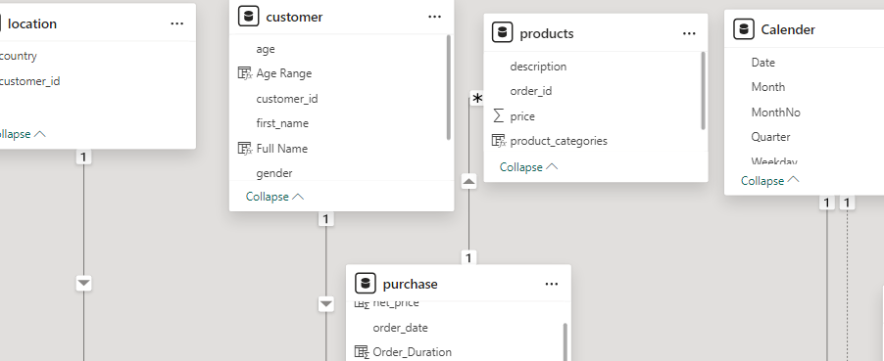
STAR SCHEMA APPOACH

Slide 5
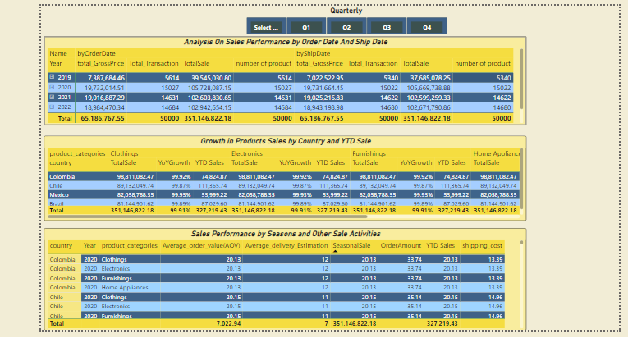
The dataset has some outlier,
some of the sales were very low in some seasons like ending of 2019 to the whole of 2020 (end of 2019_2020),
In this periods we have some factors that cause the decrease in sales ,
like the pandemic and the lockdown of many countries.

Slide 6
There are some customers that made multiple transaction, the total sales is 1% higher than the sales budget indicating that the target was achieved, despite
the discount in each order amount and the retardation in pervious year like 2020,

Slide 7
There are some geographical regions that made the most order or sales, in this dataset Colombia was the highest, followed by Chile, Mexico and Brazil.
Electronic and home appliances are mostly sold products, especially in Columbia. other products also did well.

Slide 8
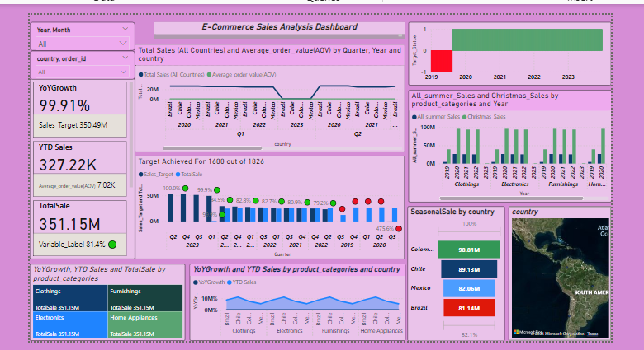
Sales Analysis Dashboard

Slide 9
Seasonal sales like Christmas and Summer sales, Columbia and Chile is the top 2 country with highest sales
The average order value has the total of 7,02%. the YOY growth is about 99.9%, YTD is about 327.22k.

Slide 10
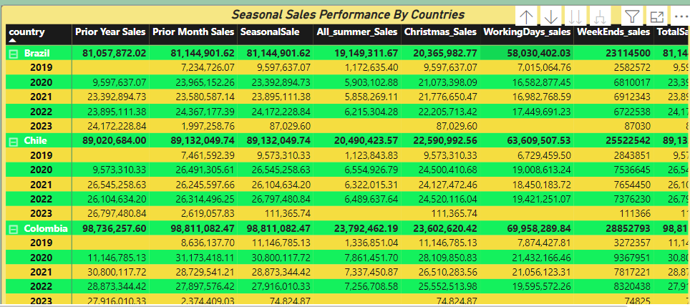
Sales Analysis By Different Seasons

Slide 11
Conclusion
this sale transaction analysis show that sales made was success despite the factors that affected some Seasonal period.
the target was achieved, Replicating this Strategy used in this transaction especially from 2021,
is highly recommended and create more nice strategy on countries that have the high and low sales

